Slide 1

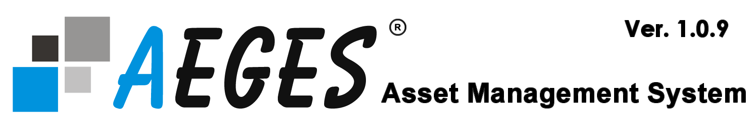

AEGES
Asset Management System
HANDS ON TRAINING

Slide 2
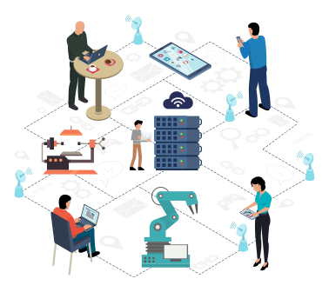
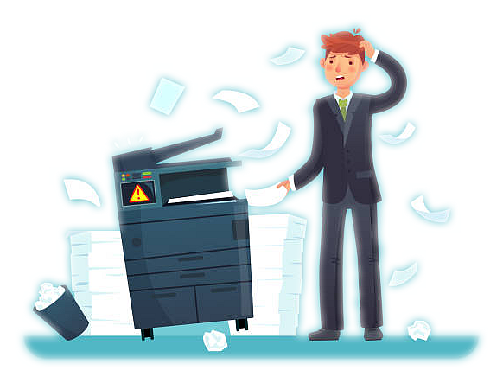

Assets Management Summary
Assets Drive Businesses

Slide 3
What is an Asset?
An asset is anything that has current or future economic value to a business.

Slide 4




What is Asset Management ?
Asset management is a systematic process of acquiring,
maintaining, enhancing, and disposing of assets in the most cost-efﬁcient manner.

Slide 5
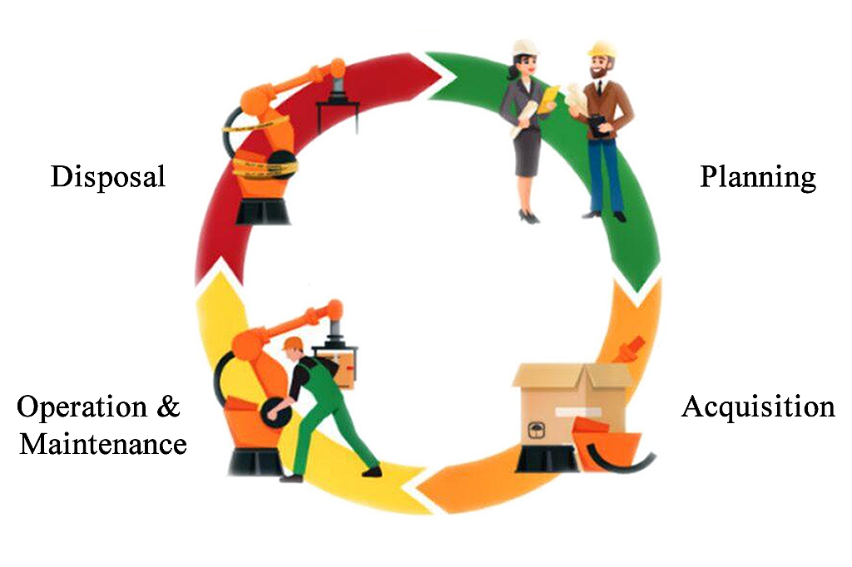
Asset Management Life Cycle

Slide 6
What is Asset Management ?
TOPICS FOR DISCUSSION
Types of Asset Management.
Development of a strategic Asset Management Plan.
The Importance of Asset Management.
The Benefits of Automating Asset Management.
AEGES Asset Management System.

Slide 7
Asset can be Classified into
Convertibility: Classifying assets based on how easy it is to
convert them into cash.
Physical Existence: Classifying assets based on their physical existence (in other words, tangible vs. intangible assets)
Usage: Classifying assets based on their business operation usage/purpose.

Slide 8
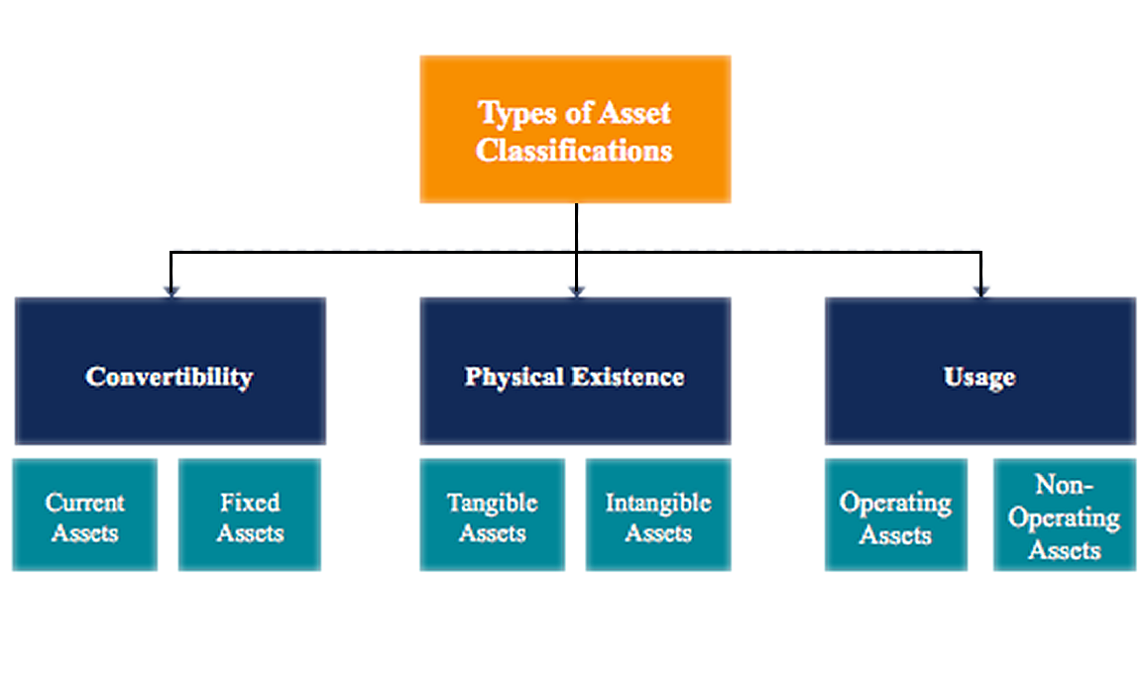
Asset can be Classified into

Slide 9
TYPES OF ASSET MANAGEMENT
Physical Asset Management
Financial Asset Management
Contractual Asset Management

Slide 10
TYPES OF ASSET MANAGEMENT
Physical Asset Management: is a strategy for implementing effective and efficient upkeep of an item or property through its entire lifecycle.
Financial Asset Management: This refers to the process of managing procurement, developing an investment strategy, controlling budget and costs, handling cash, bonds and stocks.
Contractual Asset Management: Stream lines processes like, Digital Asset Management, IT Asset Management, Contractual Maintenance and Management of Intangible Asset.

Slide 11
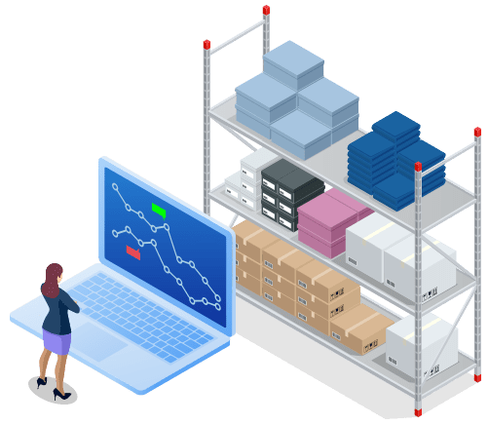
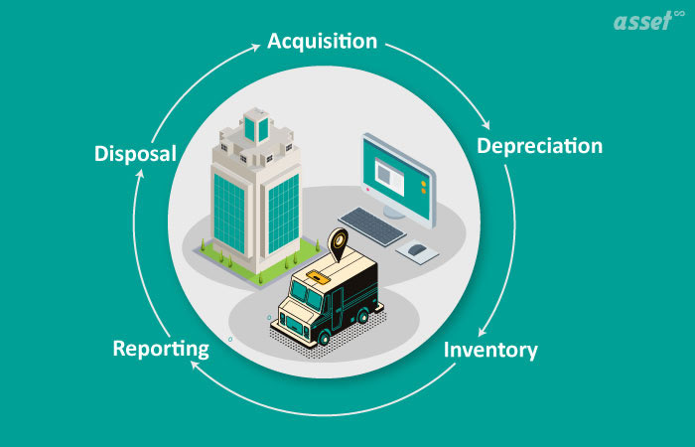
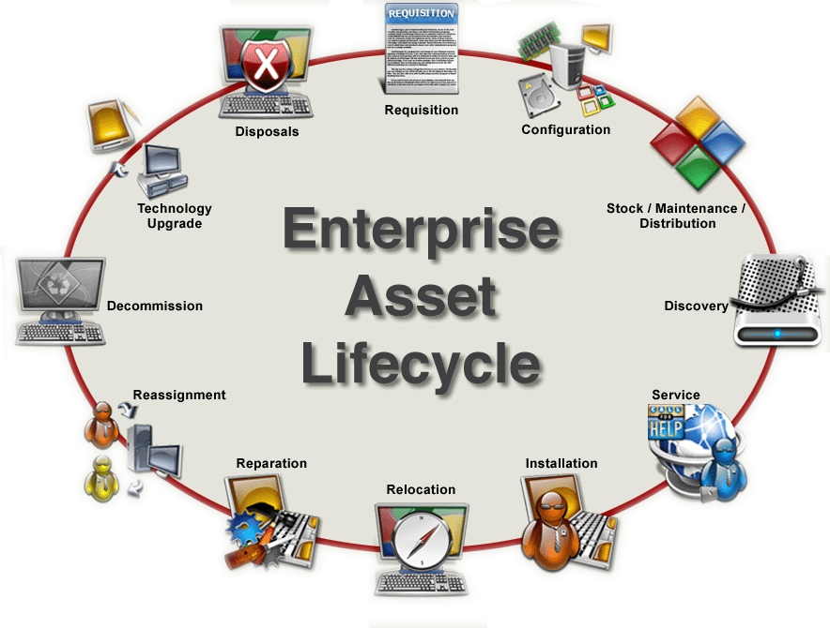
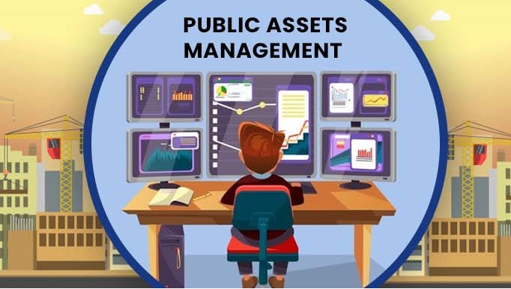
Physical Assets Management
This is the process of things like:
Inventory Management
Fix Asset Management
Public Asset Management
Infrastructure Management

Slide 12




Financial Assets Management
This is the process of things like:
Developing Investment Strategy
Managing Procurement
Handling Cash, Bonds and Stocks
Controlling Budget and Cost

Slide 13



Contractual Asset Management
This is the process of things like:
Contractual Maintenance
IT Asset Management
Intangible Asset Management
Digital Asset Management

Slide 14
Development of a Strategic Asset Management Plan
Complete An Asset Inventory
Compute Asset Life-Cycle Cost
Set Levels of Service

Slide 15
Complete An Asset Inventory: This is the way an organization lists and provides details of the assets it owns.
When preparing an inventory of a company assets, include the following
Total number of assets
Value of each asset
When each asset was bought
And the expected life cycle of each of the asset.

Slide 16
Compute Asset Life-Cycle Cost: This is the maintenance of all the physical asset cost records over entire asset lives.
During the asset life cycle additional cost are likely to come up such as:
Maintenance expenses
Condition and performance modelling
Disposal cost

Slide 17
Set Levels of Service: This is the type and amount of service the business wants their assets to provide to their customers relative to the capabilities and limitations of the assets.

Slide 18
Enables a firm to account for all of its assets
IMPORTANCE OF ASSET MANAGMENT
Helps Identify and manage risks.
Remove ghost assets in the organization inventory.
Improving compliance.

Slide 19
Save Time
BENEFITS OF AUTOMATING ASSET MANAGEMENT
Save Money.
Increase Accuracy.
Improve Accountability.
Maintain Consistency.

